Slide 1
Happy Journey

Slide 2
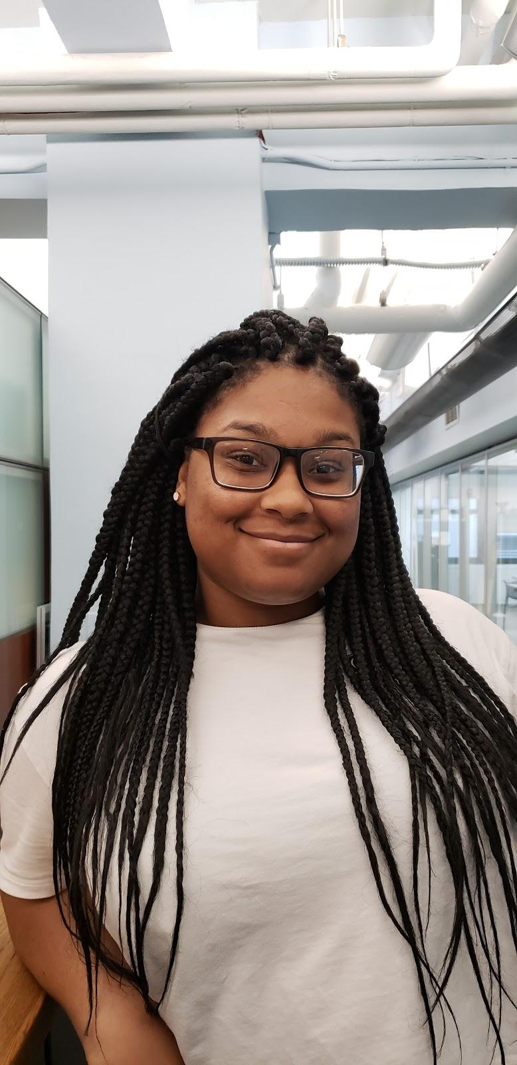
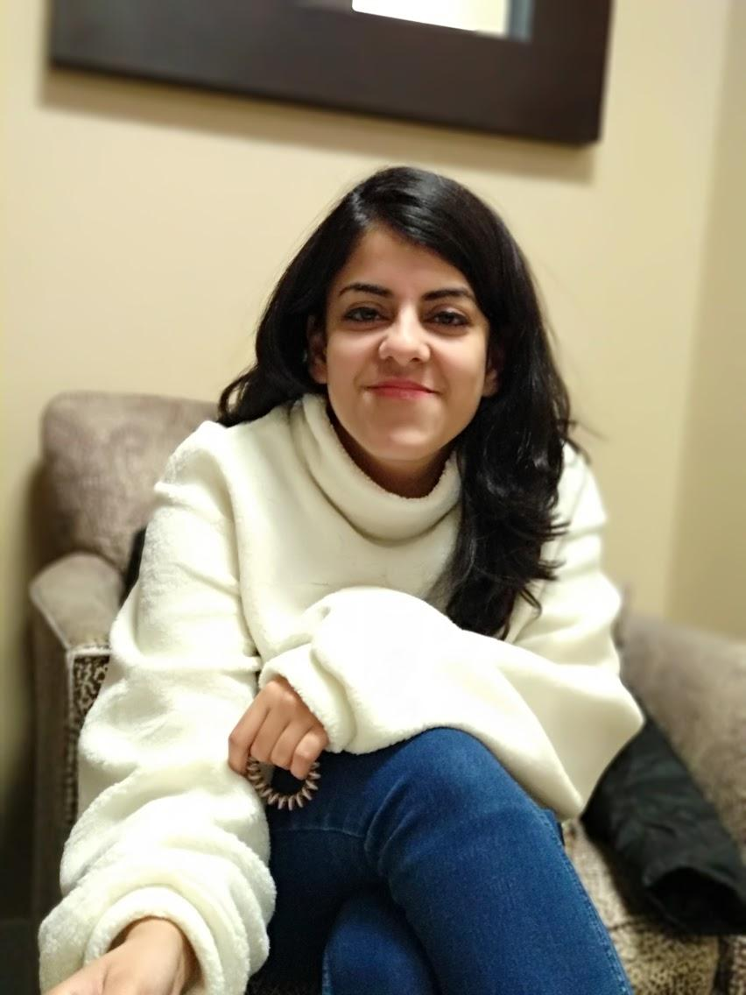
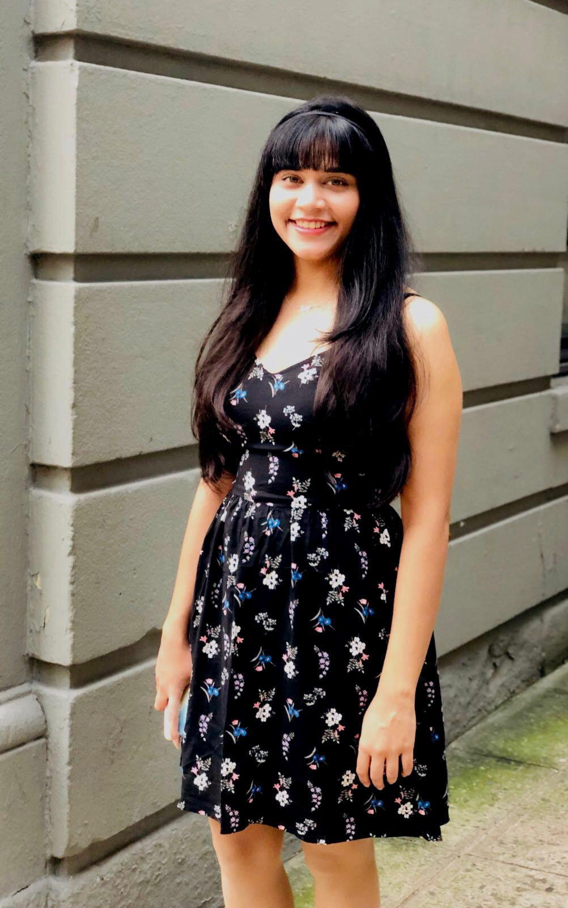
Hello!
We are here because we love to improve User Experience.
Presented by-Jennifer Rhau, Kajal Purwar, Sanchita Ochani
Notes:
KAJAL
Introduce us as team

Slide 3
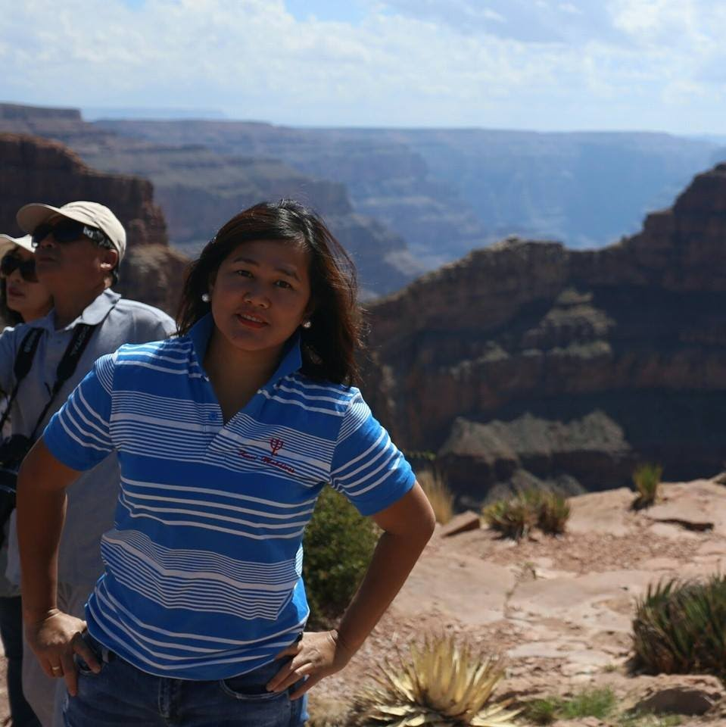
“ …. packing is extremely frustrating”

Slide 4

“..hurricane ruined my trip and I was forced to stay indoors the whole trip.”

Slide 5
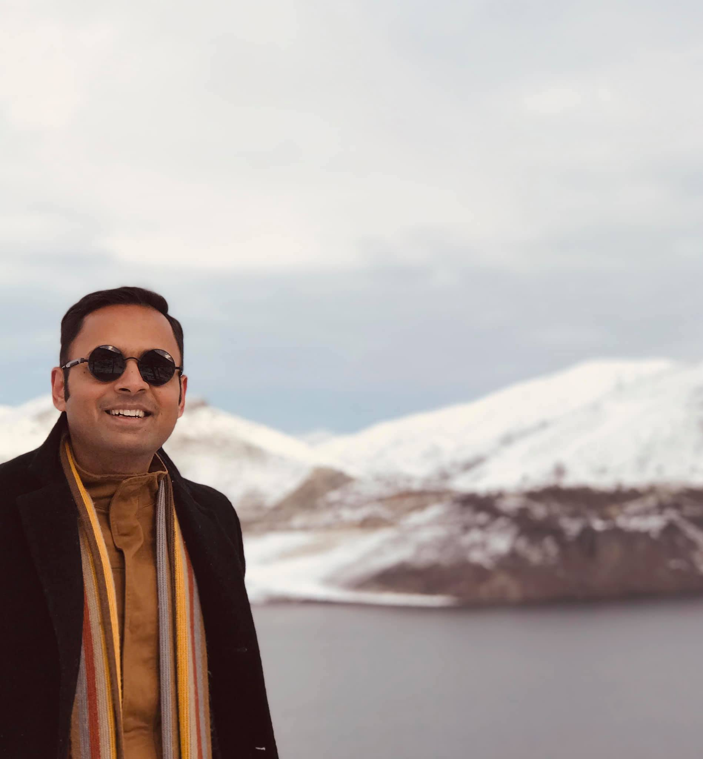
“Sometimes it's hard to find vegetarian food”

Slide 6

“My flight was cancelled and I didn't get any update”

Slide 7
Traveling is such a tedious task, we wanted to ease the experience.
Notes:
KAJAL
This is our problem statement. After our initial research this is what we decided we had to fix

Slide 8
Goal
“Our goal is to enhance the planning process of a trip, and at the same time, make it stress-free.”
Notes:
KAJAL

Slide 9

Personas
This is Naiomy from Paris, Currently working as Manager at Dyckman Farmhouse Museum, She like history, traveling and reading, She has travel more than 15 countries.
Apart for work she is always ready to try new thing and explore nearby area. She spends her weekends in networking and meetups also she likes teaching and investigating about history and mostly she attends events and conference on regular basis around the globe.
She struggles to make itinerary as She is a working woman.
She feels difficult to recall all stuff to carry and she take many days to plan everything accordingly.
Name: Naiomy Rodriguez
Age: 30
Profession: Manager at Museum
Hobbies: History, Reading, Traveling, Exploring, Music.
Prototype
Notes:
KAJAL
Jennfier
kajal - Naiomy is already using happy journey and here is her planning to the back and forth trip to paris to nyc. whenever, She wants, she can add anything right away.

Slide 10
Gaps in Existing Apps
Most websites like Kayak only help you with flight and hotel bookings, without focusing on the other aspects of planning a trip.
Apps like Yelp can only be reliable in countries where the app usage is heavy.
Notes:
Sanchita
Comparative Analysis -
Kayak does this … this place does that, but we come and bring allt hose funcitonalities together

Slide 11
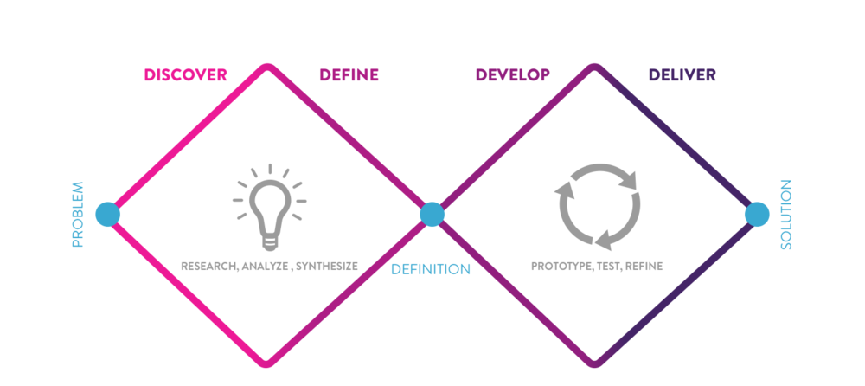
Process
Notes:
Sanchita
We used this process for our research

Slide 12
DISCOVER
Notes:
Sanchita
Discover is the first part of our project
Here is what it entails

Slide 13
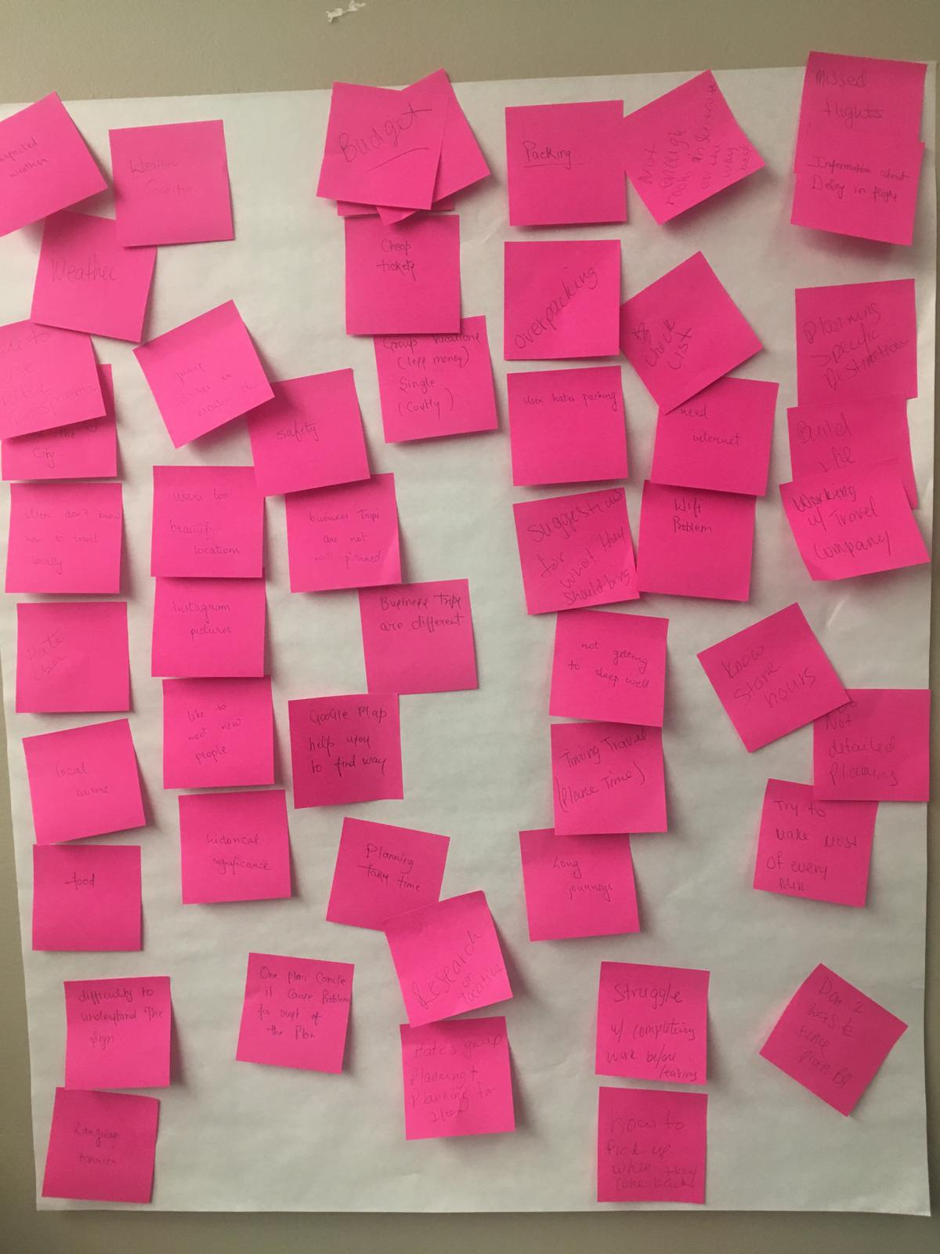
Research Outcomes
Users hate packing.
Users can’t keep track of their expenses.
Users struggle with planning.
Wall full of ideas
Notes:
Sanchita
Talk about findings

Slide 14
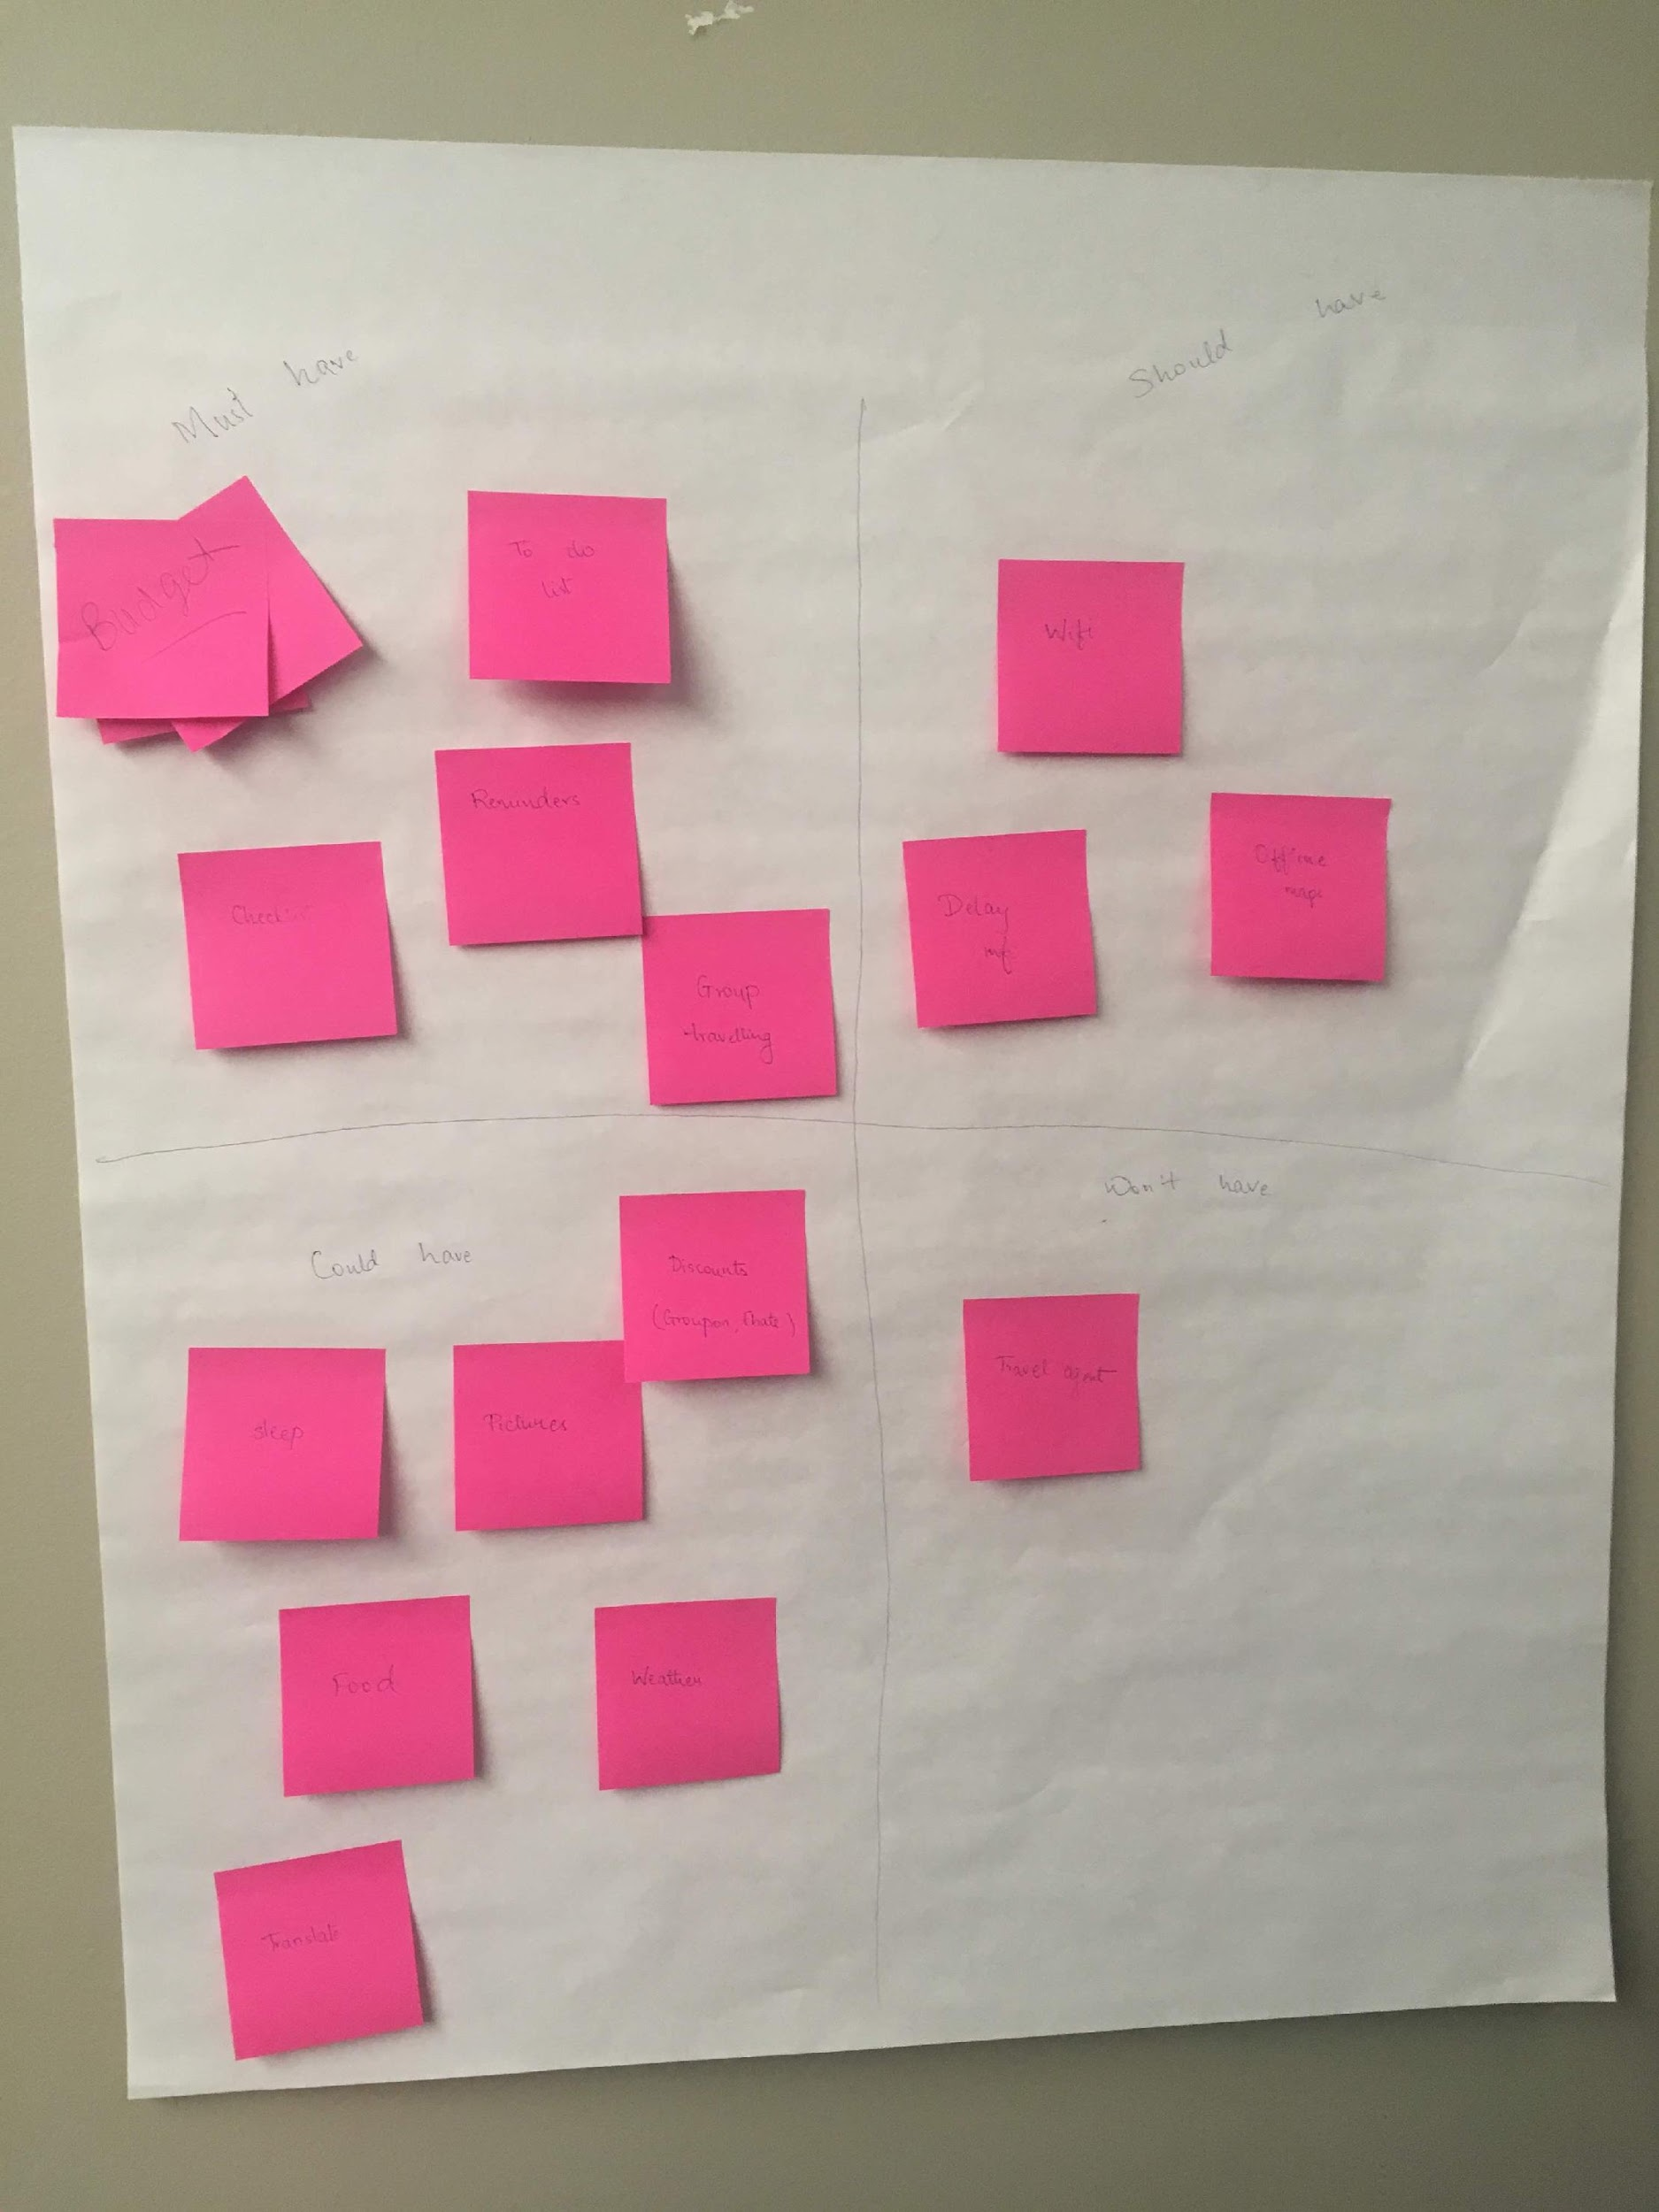
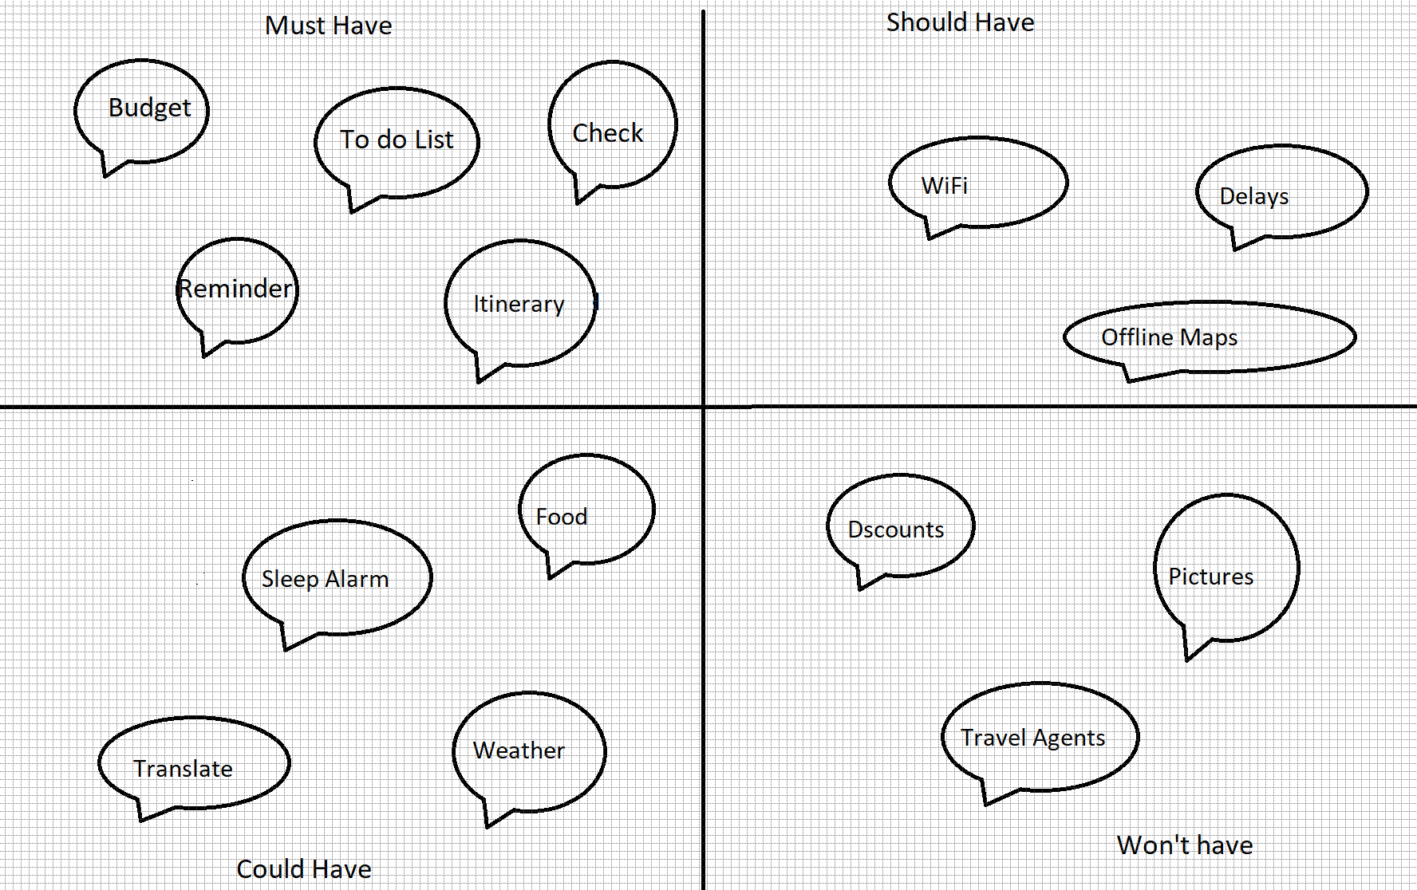
MOSCOW
Notes:
Sanchita will do moscow

Slide 15
Define

Slide 16
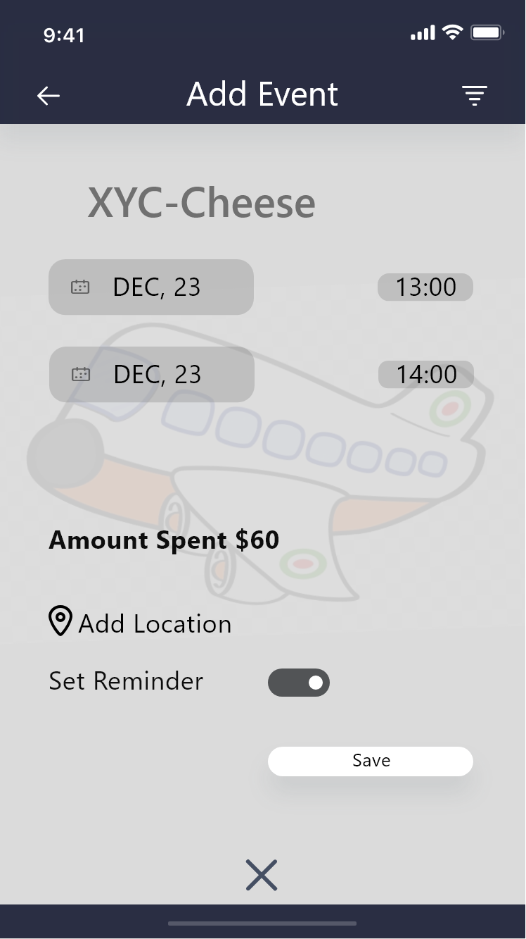
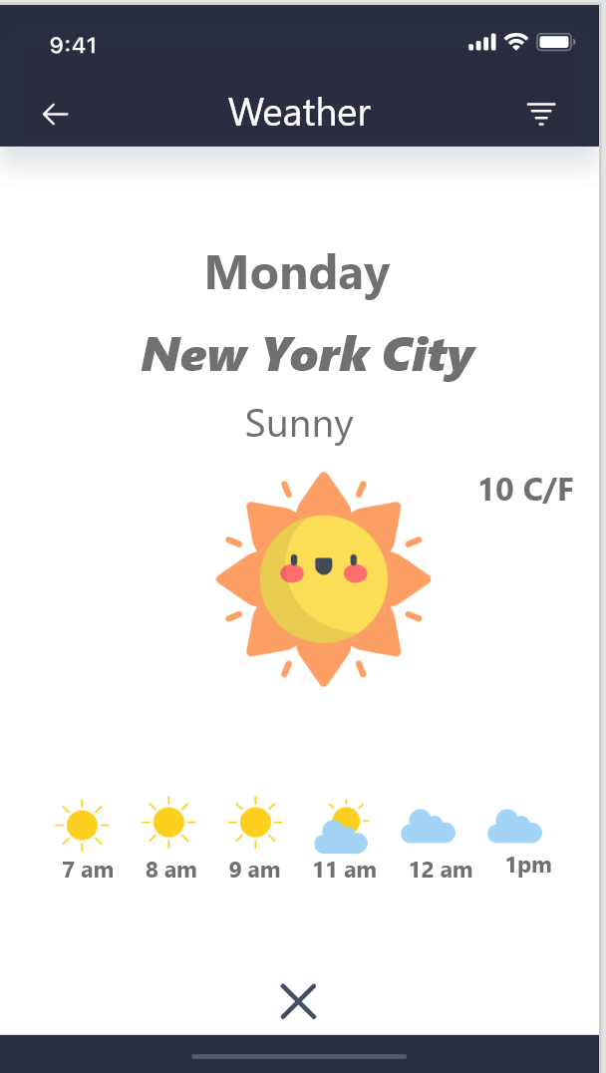
HEURISTICS
User Control And Freedom
Flexibility And Efficiency of use
Consistency and standards
Aesthetic and minimalist design
Match between system and the real world
Notes:
Jennifer Rhau
**ADD A PICTURE OF APP SCREEN**

Slide 17
DEVELOP

Slide 18
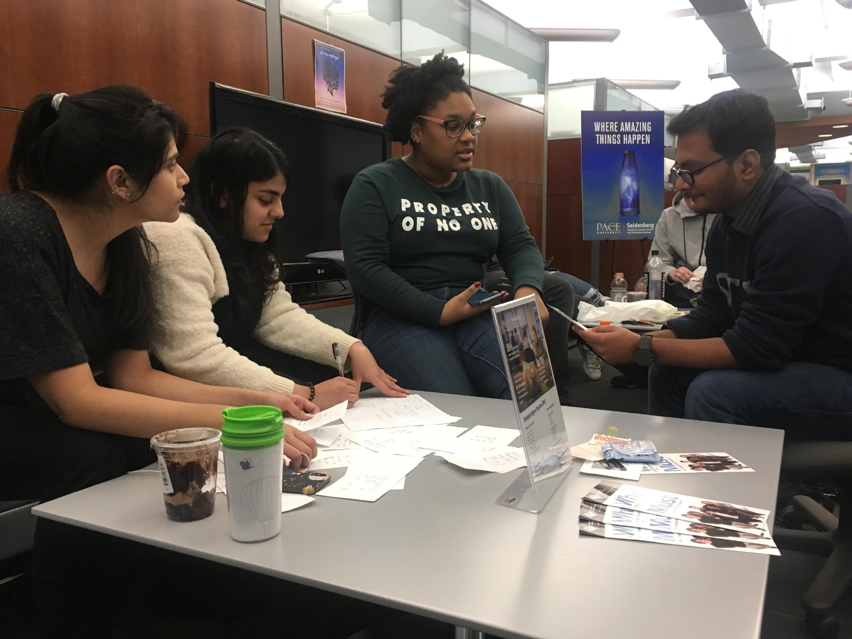
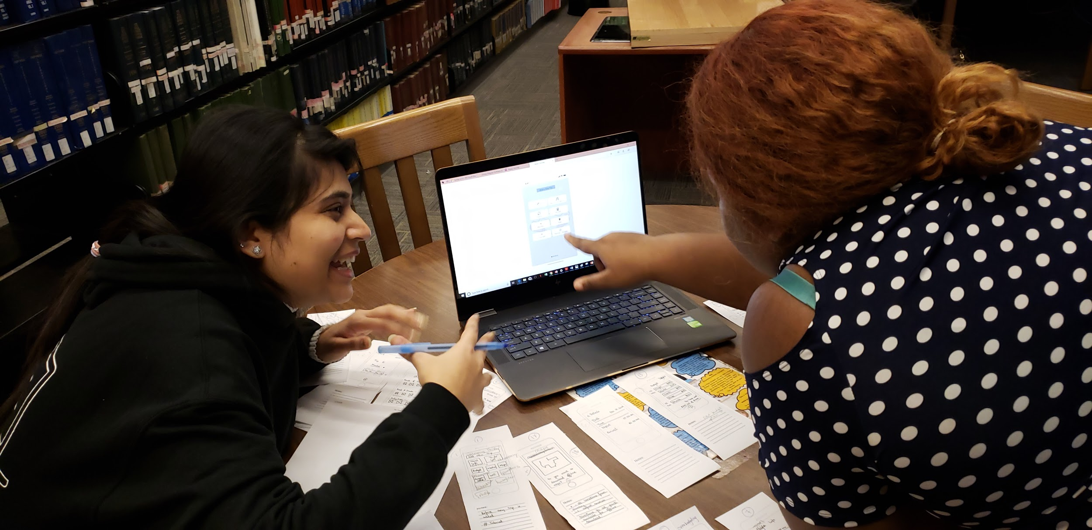
Usability Testing
Notes:
Sanchita

Slide 19
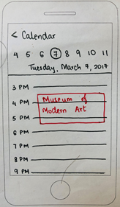
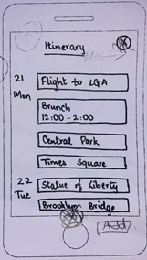
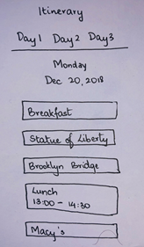
Major Changes in Itinerary
1
2
3

Slide 20
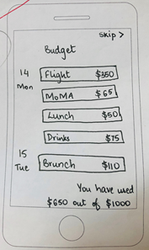
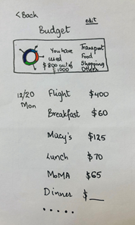
Major Changes in Budget
1
2

Slide 21
Deliver
Notes:
Sanchita

Slide 22
Solutions
Notes:
Jennifer
.. So after all of this we decided to create what you saw in the prototype:
Budget Page
Itinerary
Recommendations
Mapped out destinations

Slide 23
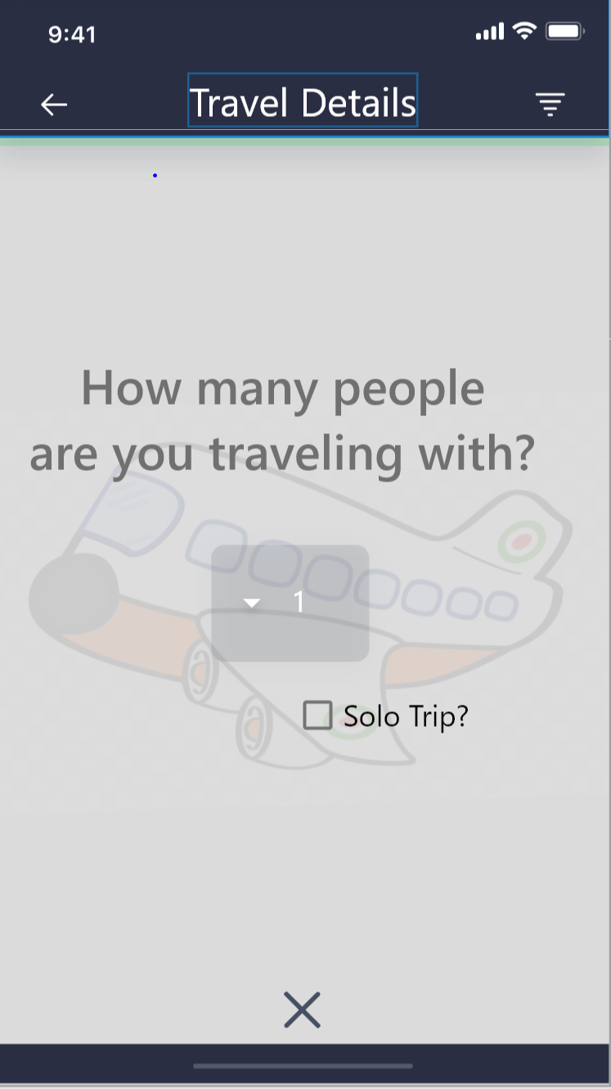
To be continued...
Notes:
Jennifer

Slide 24
Thanks!
Any questions?

Slide 25
Appendix
Screener:
Do you plan to travel in the future?
Do you do research before going on a trip?
Questions:
1) What inspires you to go to a new place?
2) Can you tell me how you create your itinerary i.e. What is your process?
[P] How detailed do you make your itinerary?
3) Can you walk me through your most recent trip planning experience?
4) How do you manage your expenses for a trip?
5) How long does the planning and organizing your trips usually take?
What are some important factors you consider while planning for a trip?
Q6 When you plan your trip, how often you depend on the traveling agent.
o Never
o Very Less
o Sometime
o Mostly
Q7 what are some important factors you consider when planning for a trip?
Q8– What tools do you use to make decisions about it? Are they helpful?
Q9 During your trip, which is your most concerning part of your journey ( rank in order)
o Time
o Budget
o Accommodation
o Sites
Q10 When you are at your destination site, what you prefer, Their local transport system of Private Cab Services and why?
Q11 How you deal with currency change (if applicable).
Q12 on an average, How much you are able to cover the Trip plan that you have a plan before starting it.
Demo Link
https://xd.adobe.com/view/70752850-a516-497e-57ce-e52e2a524de5-0644/?fullscreen
Usability screener
Travel Notification
Scenario: You are going to london and you want to get reminders about flight details
Task: Enter (flight) details
Itinerary
Scenario: You are planning a trip to NYC for the first time. You’ve decided you will go see your first Broadway show and get dinner after with some friends
Task: Add Broadway show from 6-9 and Dinner from 9-11 on your to-do list
Budget
Scenario: You're planning your trip to Cancun. You’ve set a max Budget of $1200, but are about to add as venture that is $100 over budget.
Task: Deal with over budget message and act accordingly .
Suggestions
Scenario: You’ve taken a trip to Berlin, the restaurant you had decided on is not as appetizing as expected.
Task: find a new restaurant
To-Do
Scenario: After finishing with your budget, you remember you’ve forgotten to add something some items to your to-do [packing] list
Add “Pack charger to packing list”

